Slide 1
Into the Tidyverse Session 3a
Course written by Tim Hardgreeves

Slide 2
Statistics in R

Slide 3
R for Statistics:
Statistics is R's speciality
Despite this we've barely even used this functionality
A statistic is a function of data points
Examples include mean, median, maximum, etc.

Slide 4
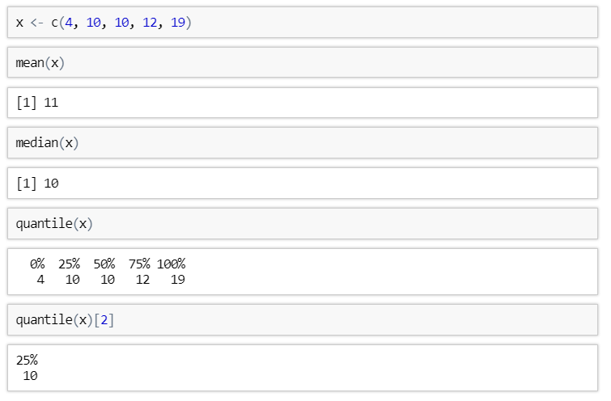
Measures of Location

Slide 5
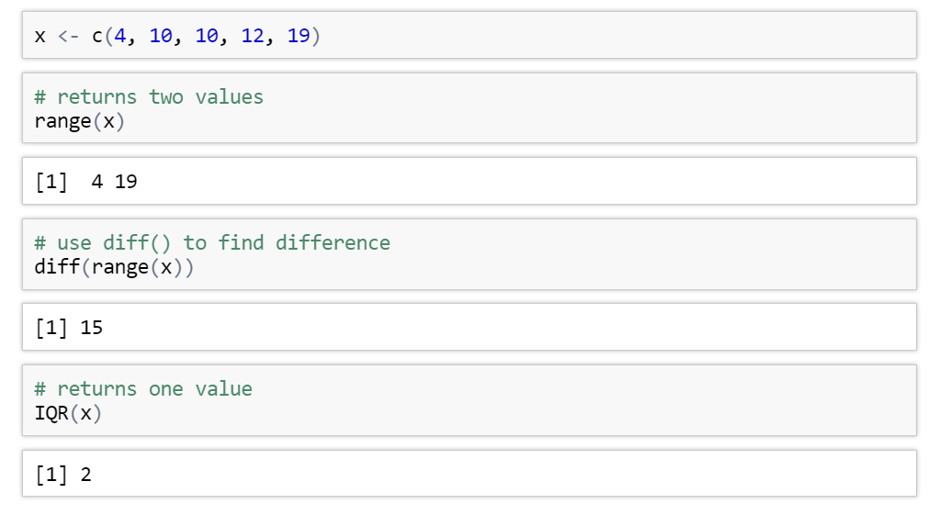
Measures of Spread

Slide 6
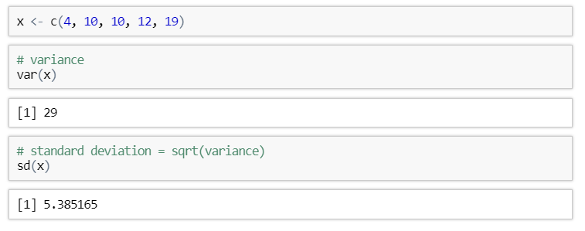
Measures of Spread

Slide 7
Exercises to try
Extract the displ column from the mpg dataset and assign it to the object x
What is the mean and median of x?
What are the largest and smallest values of x ?
Find the upper and lower quartile of x. What about the inter-quartile range?
What is the variance and standard deviation of x?

Slide 8
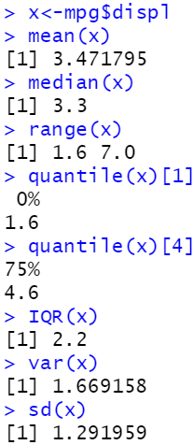
Answers

Slide 9
Careful of missing values

Slide 10
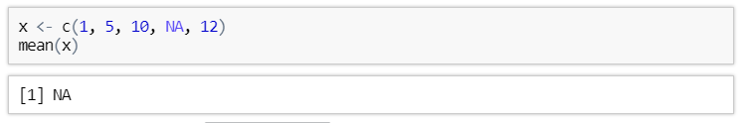
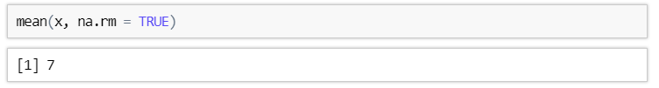
Handling a missing value
If a vector containing a missing value (NA) has a statistical transformation applied to it then the result will always be NA
This can be avoid by setting na.rm = TRUE

Slide 11
Exercises to try
What do you think the result of 5 + NA will be? Try it and see if you were correct
Replace + with some other arithmetic operators. Is the result always the same?
Calculate the median of the vector c(2, 6, 3, 4, NA), ignoring missing values

Slide 12
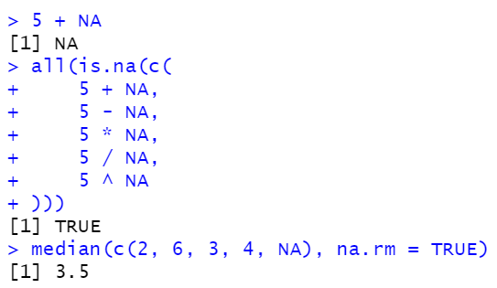
Answers

Slide 13
Making comparisons

Slide 14
comparisons
It is very useful to be able to compare two values and ask how they relate - Is one larger than the other? Are they the same value?
We can go even further by adding more then 1 comparison parameter together
This can be done with ‘Boolean operators’ and or ect

Slide 15
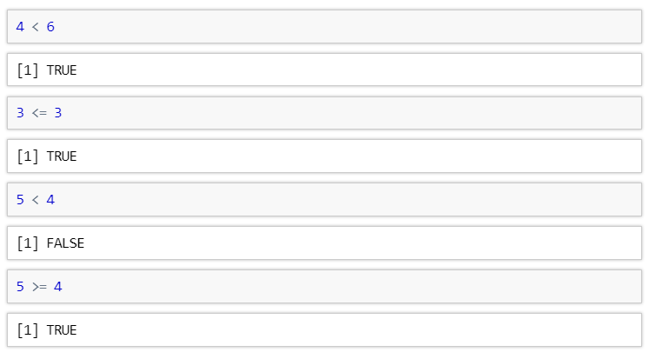
Ordering Comparisons

Slide 16
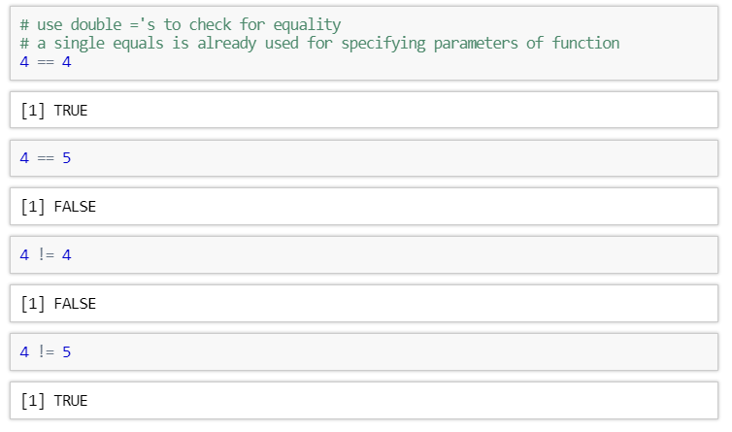
Equality Comparisons

Slide 17
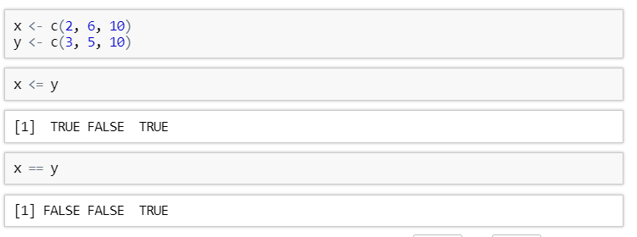
Comparisons on Vectors
All comparisons in R are vectorised.
This means that they act element-wise on vectors
You can transform a logical vector into a single logical value using all() and any()
any(x >8)

Slide 18
Exercises to try
Take the mtcars dataset for these exercises
Use the format data[data$column_name operator(>,<,==) value ,]
this is effectively saying data[ rows to select, columns to select] and if its left blank it will select everything
Filter values in the dataset by cyl column that are equal to 6
Filter values in the dataset by mpg values that are greater than or equal to 15
Bonus: is the mean of mpg column greater then the median of the mpg column

Slide 19
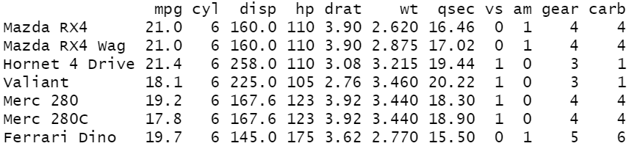
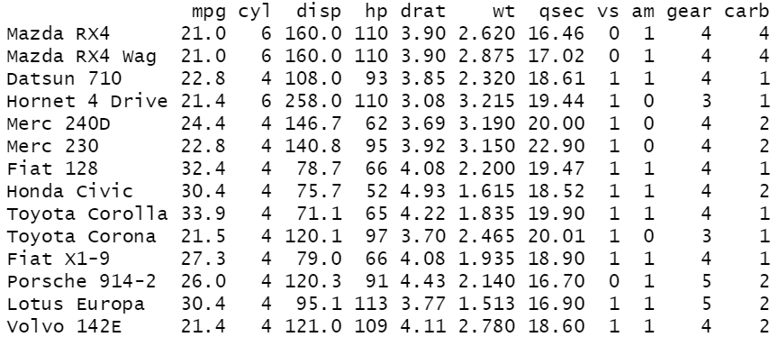

Answers
1)
2)
3)

Slide 20
Boolean Operators

Slide 21
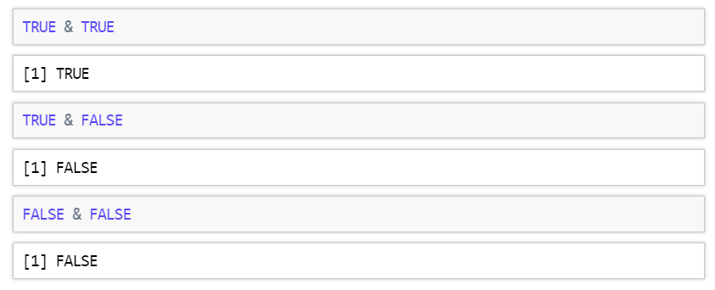
Boolean Operators and
Logical/ Boolean Operators
These act on logical values

Slide 22
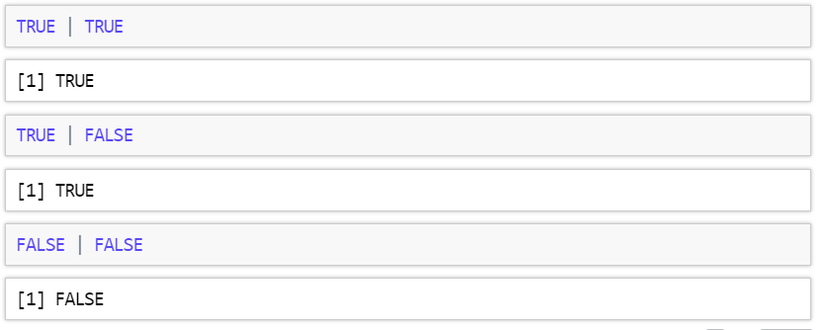
Boolean Operators or

Slide 23
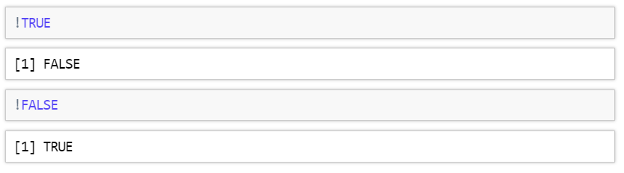
Boolean Operators not

Slide 24
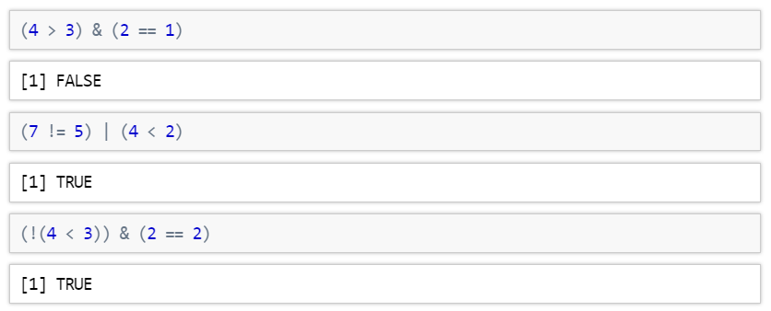
Combining Boolean Operators
The brackets above are not actually needed due the order of operations in R
It is best to always include them until you have a lot of practice though as this avoids errors that are difficult to diagnose

Slide 25
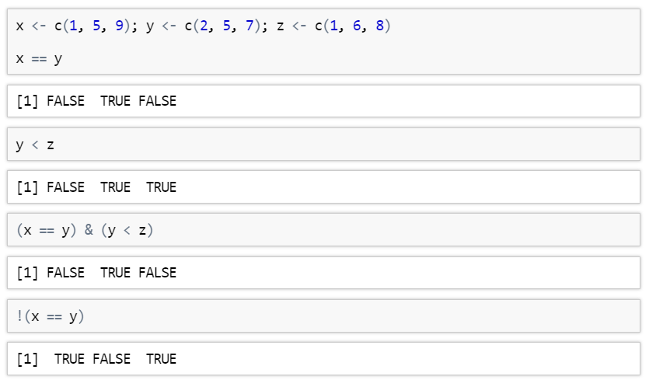
Boolean Operators on Vectors

Slide 26
Exercises to try
Predict what answers you will get from the following R statements:
((4 > 3) & (7 == 6)) | (5 <= 8)
FALSE & !FALSE | TRUE
Look at ?Syntax to understand the order of the operations
3) Filter values in the dataset by cyl column that are equal to 6 or mpg values that are greater than or equal to 15

Slide 27
Answers
Replacing the comparisons with their logical values we get (TRUE & FALSE) | TRUE. TRUE & FALSE becomes FALSE leaving us with FALSE | TRUE which is TRUE.
Looking at ?Syntax, we see that the order of operations for Boolean operators is ! then &, then |.
We therefore first evaluate !FALSE to get TRUE. Then we look at FALSE & TRUE to get FALSE. Lastly we have FALSE | TRUE which is TRUE. Note that if we had evaluated | before &, we have obtained the opposite result.

Slide 28
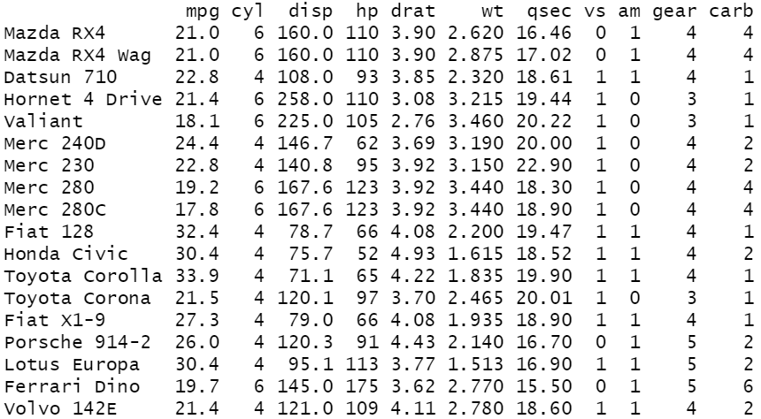
Answers

Slide 29
Bonus Questions

Slide 30
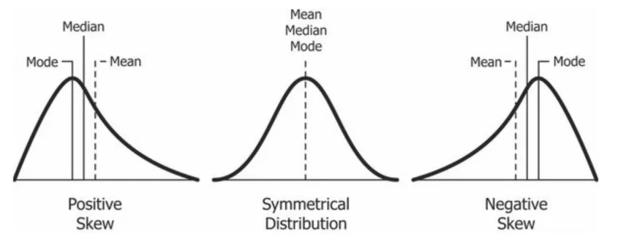
Testing if the data is skewed
Skew:
The relative position of the mean and median.
At 0, mean = median, and the data is normally distributed.
Kurtosis
The size of the tails in a distribution.
In R, values much different from 0 are non-normally distributed.

Slide 31
Skewness, Kurtosis and histogram distributions
These packages aren’t in our base R or tidyverse package we need to use ‘moments’
install.packages('moments')
library(moments)
skewness(x)
kurtosis(x))
hist(x)

Slide 32
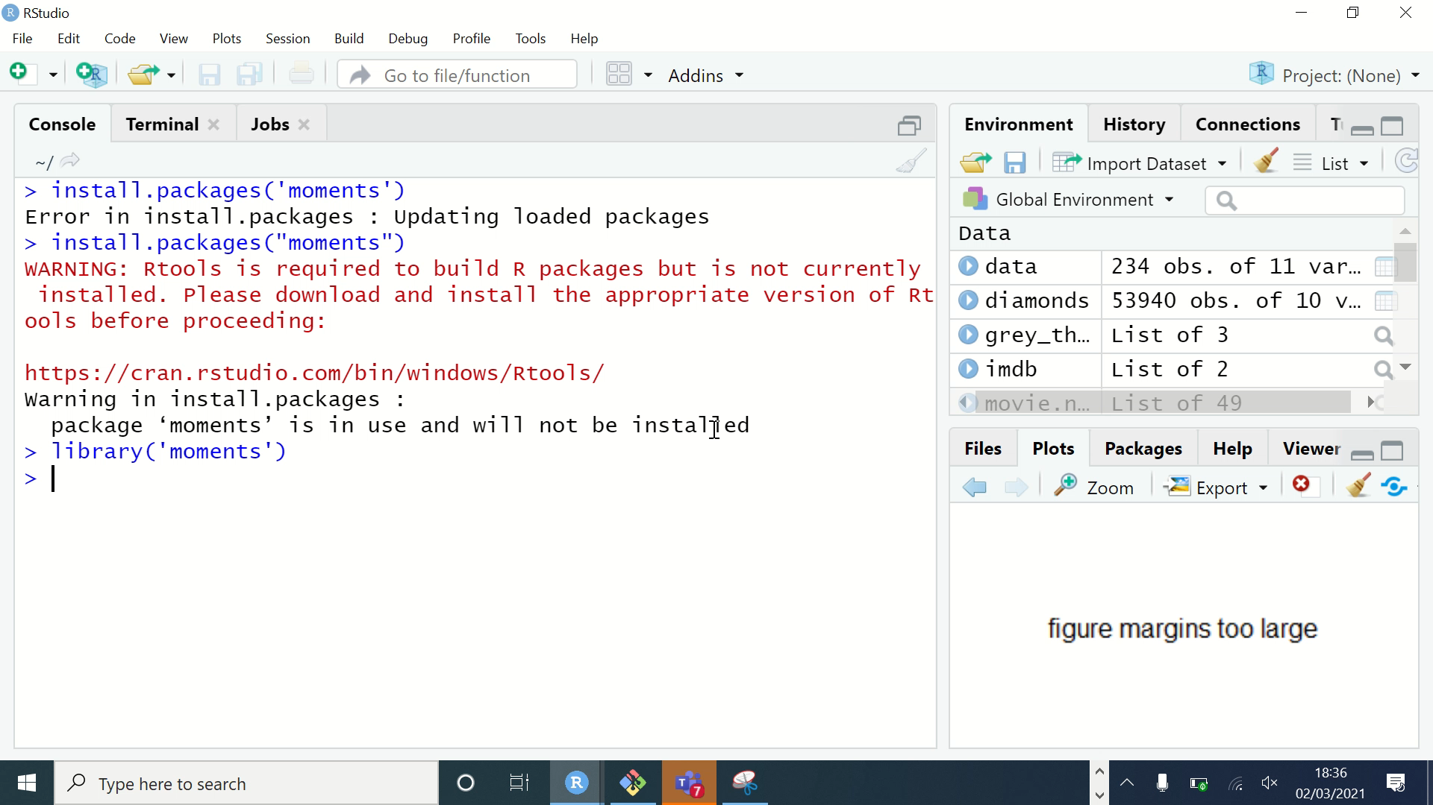
Exercises
Using the iris data select the column Sepal.Length and test its skewness() and kurtosis()
To select a column remember to use <dataset name>[[<col name>]]
Plot a histogram of Sepal.Length
If you get this error :
Increase the height of your plot window

Slide 33
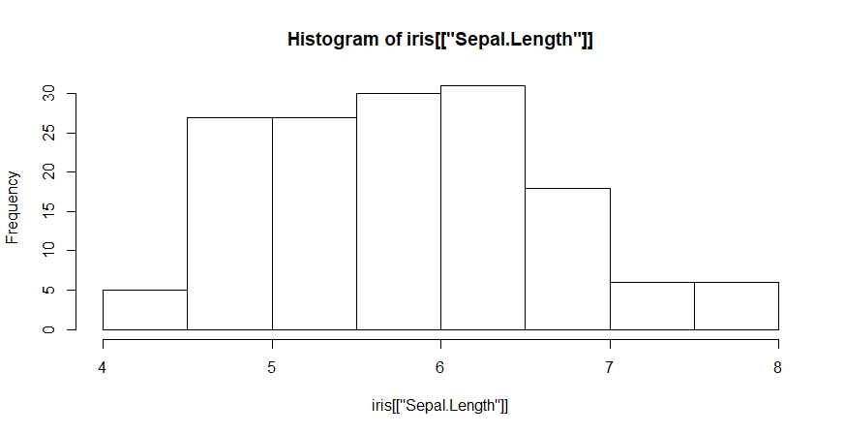
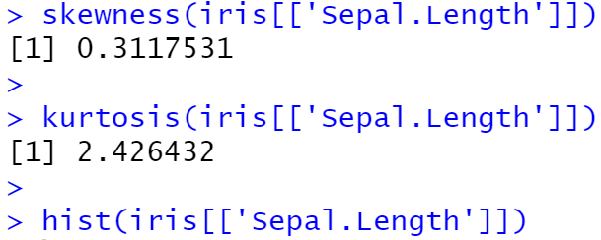
Answers

Slide 34
Value Meanings
Skewness:
A zero means no skewness at all (normal distribution).
A negative value means the distribution is negatively skewed.
A positive value means the distribution is positively skewed.
Kurtosis:
A kurtosis greater than 0 means that the distribution has a high peak with skinny tails.
A kurtosis less than 0 means that the distribution has a low peak and heavy tails.

Slide 35
Next Time ….
Manipulating Dataframes:
Mutating
Filtering
Selecting
Summarising
Arranging
See you then !

Slide 36
Into the Tidyverse Session 3b
Course written by Tim Hardgreeves

Slide 37
Transforming Data
Taking a dataset, transforming it into a form that meets our needs, and using it to answer questions

Slide 38
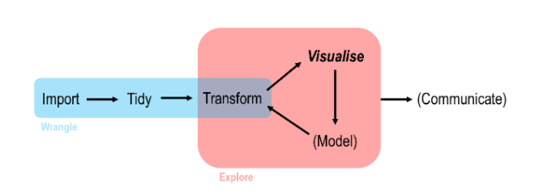
Data Analysis work flow in R

Slide 39

Dplyr
dplyr is the third tidyverse package that we will be looking at
It has five main features, referred to as the dplyr verbs
These allow you to filter a dataset or transform it by creating new variables/summaries
You can also use these to reorder your observations to make a dataset easier to work with

Slide 40
The dplyr Verbs
There are five key dplyr functions referred to as verbs.
These alone allow you to handle the majority of data manipulation tasks
They are:
filter() - pick observations by their values
arrange() - reorder observations based on their values
select() - pick variables by their names
mutate() - create new variables as functions of existing variables
summarise() - collapse many values down to a single summary

Slide 41
The dplyr Verbs
All five main verbs plus the group_by()verb work similarly:
The first argument is a data frame
The subsequent arguments describe what to do with the data frame, using the variable names (without quotes)
The result is a new data frame

Slide 42
Filtering

Slide 43
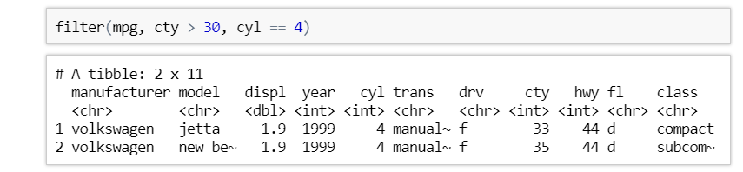
Filter Rows
Warning: Don't confuse == with = else you'll get an error

Slide 44
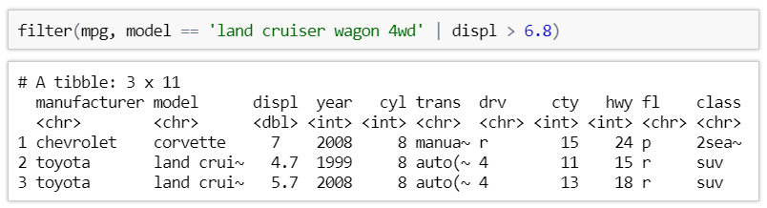
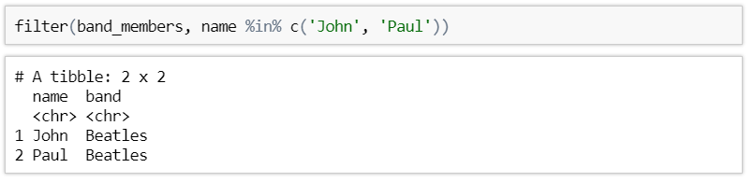
Filter with Boolean Operators
We can use Boolean operators in filter clauses:
Another useful operator is %in% which checks if a value is in a vector

Slide 45
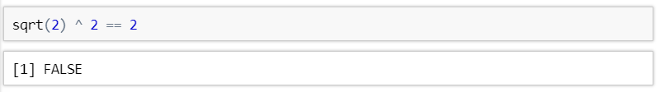
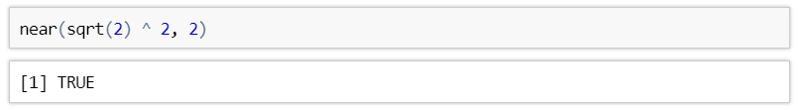
Handling floating point numbers
We can use Boolean operators in filter clauses:
When handling values that are not integers, use the near() function to check for equivalence

Slide 46
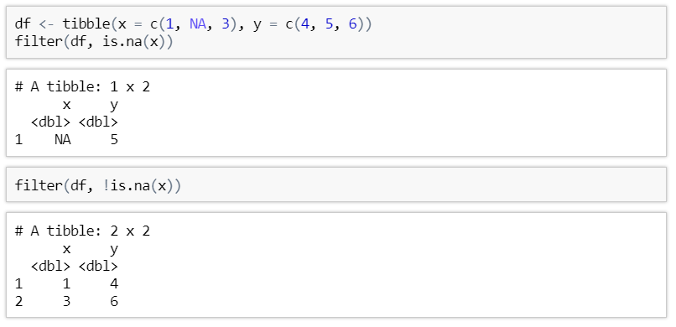
Handling Missing Values
In many cases you may want to either remove missing values or look only at rows which contain a missing value
The is.na() function can be used to this extent.

Slide 47
Exercises to try
How many automatic cars by Audi are in the mpg dataset?
Hint use nrow() around the filter function to deduce the number of rows
Who makes the only two cars with a highway mileage above 41 miles/gallon?
Are there any flowers in the iris dataset with petals that are wider than they are long?

Slide 48
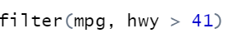
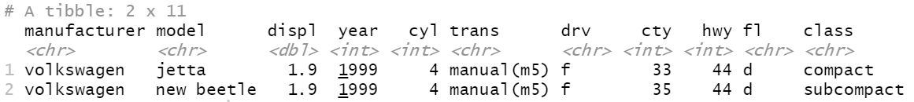
Answers
1)
2)
3)

Slide 49
Arranging

Slide 50
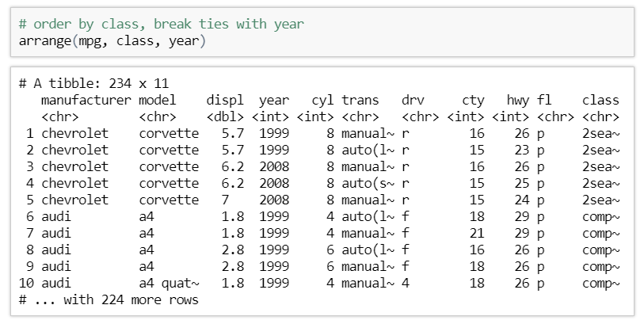
Arrange Rows
arrange() orders observations by one or more variables in ascending order
The observations are ordered by the first column, then ties are settled by the second, etc
Missing Values are sorted at
the end

Slide 51
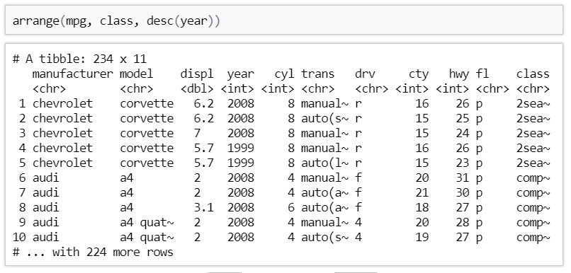
Descending Order
You can wrap a variable in desc() to use descending order for that column

Slide 52
Exercises to try
Using arrange(), find the car in the mpg dataset with the best city mileage. What about the worst?
Order the iris dataset by the product of the petal length and width (Note: you don’t need to create a new variable using mutate to do this you can just use the * operator)

Slide 53
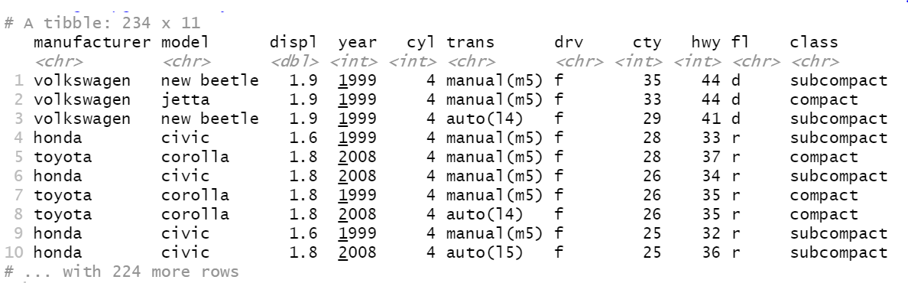
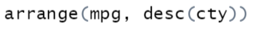
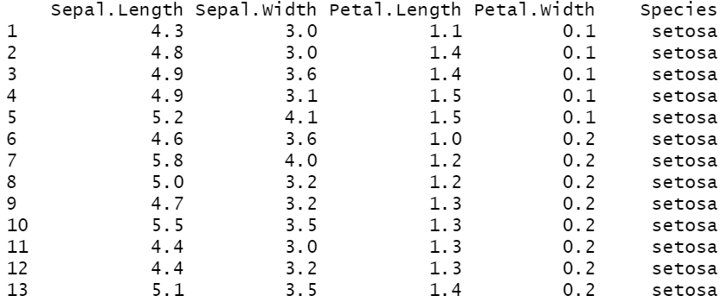
Answers
1)
2)

Slide 54
Selecting

Slide 55
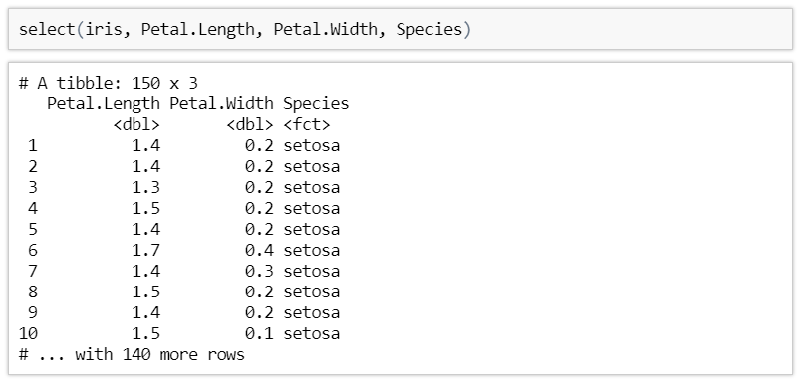
Select
It is not unusual to get be given a dataset with hundreds or even thousands of columns
In this case, you may want to narrow this down to variables you actually care about

Slide 56
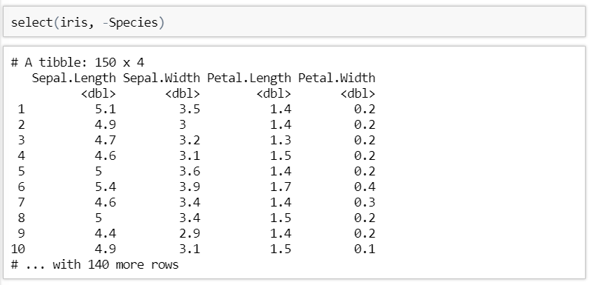
Dropping Columns
You can get rid of columns by prefixing their name with a - symbol

Slide 57
Selecting Ranges
You can use the : operator to select or remove columns in a range (inclusive)
It also works with -

Slide 58
Helper functions
There are a number of helper functions you can use within select():
starts_with('abc')
ends_with('xyz')
contains('ijk')
num_range('var', 2:4) - matches var2, var3, var4
everything - matches all variables
See ?select_helpers/?select for more information

Slide 59
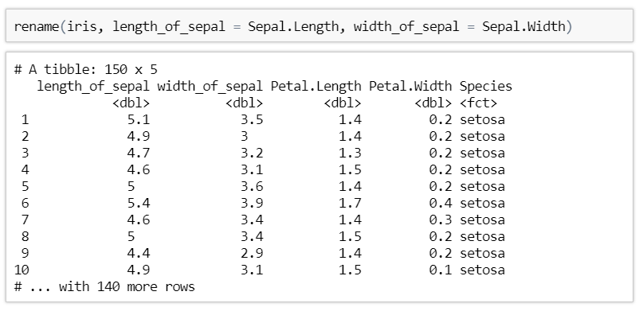
Renaming Columns
select() can be used to rename columns but this can be more easily achieved using rename()

Slide 60
Exercises to try
Re-order the columns of the iris dataset so that Species is first. To do this, select Species first and then use the everything() helper to select everything else
Rename the displ column in mpg to eng_size

Slide 61
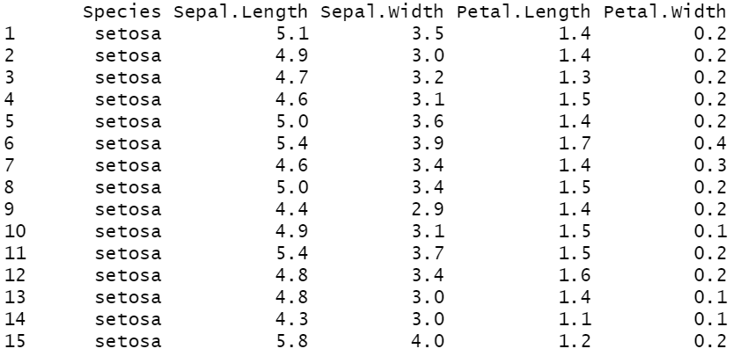
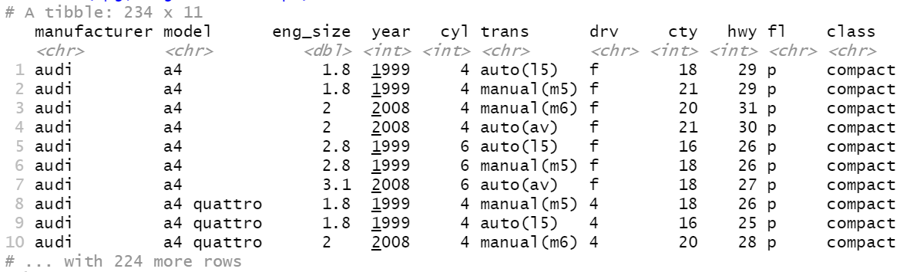
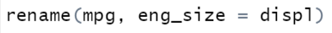
Answers
1)
2)

Slide 62
Mutating dataframes

Slide 63
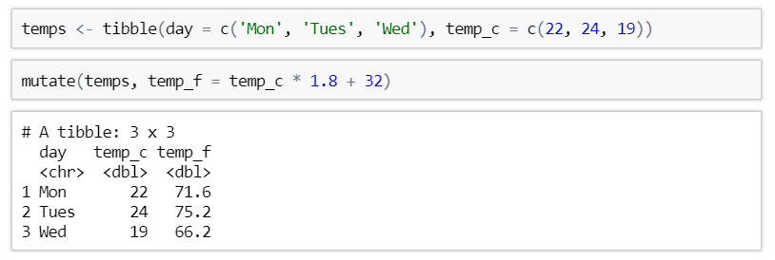
Adding new columns based on existing
mutate() lets you transform one or more variables currently in your dataset to create a new one
The new column is added at the end of the dataset or in the same place as before if it overwrites an existing column

Slide 64
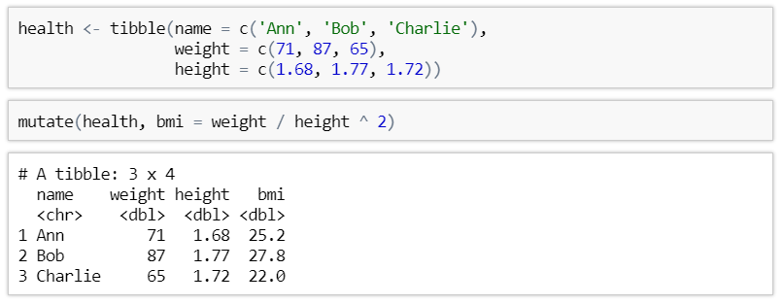
Mutate with multiple variables
You can use multiple variables to create a new column

Slide 65
Exercises to try
Using the mpg dataset, create a new column called cty_km_l which measures the city mileage in kilometres per litre (Hint: 1 mile ~ 1.6 km, 1 gallon ~ 3.8 litres)
Create column called max_dimension for the diamonds dataset which contains the maximum of the values in the columns x, y, z

Slide 66
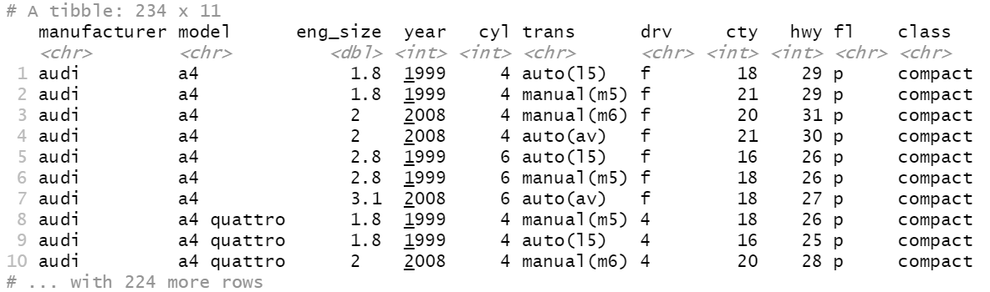
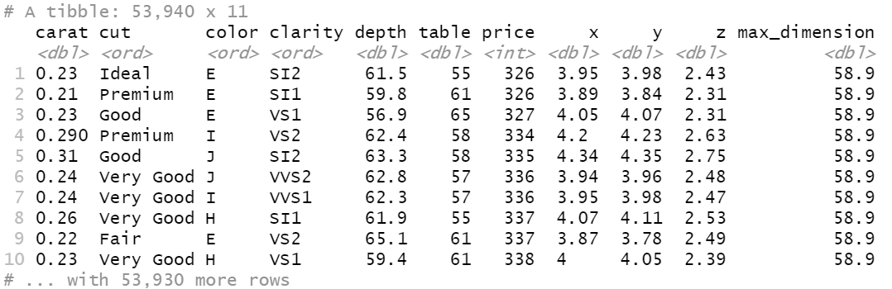
Answers
1)
2)

Slide 67
Summarising

Slide 68
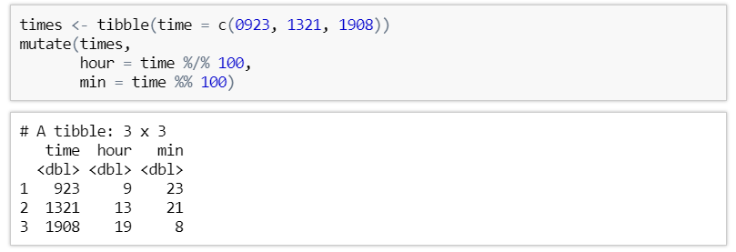
Useful Functions
Basic arithmetic operators: +, -, *, /, ^
Aggregate functions: x / sum(x) (proportion), y - mean(y) (centring)
Modular arithmetic: % / % (integer division), %% (remainder)
Logarithms: log() (natural), log2(), log10()

Slide 69
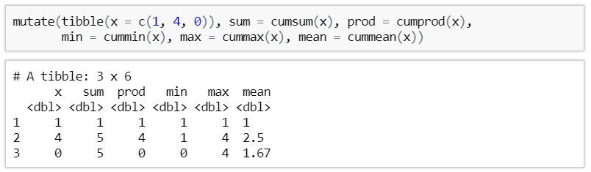
Useful Functions
Cumulative aggregates: cumsum(), cumprod(), cummin(), cummax(), cummean()

Slide 70
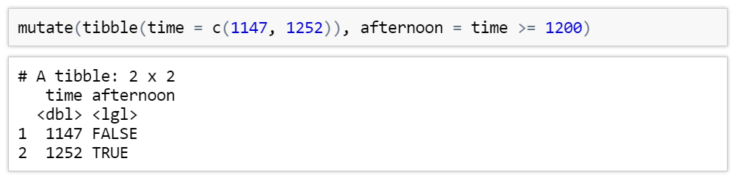
Useful Functions
Logical Comparisons: <, <=, >, >=, ==, !=

Slide 71
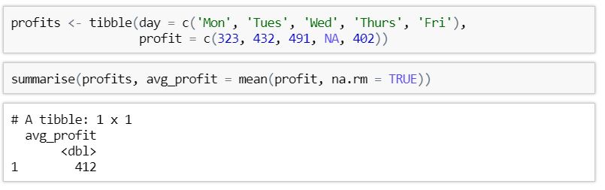
Summarize Function
summarise()allows you to collapse a data frame to a single row based on an aggregation function

Slide 72

Group Summarize Function
summarise() by itself is not very useful.
We could have done this with mean(profits$profit, na.rm = TRUE)
The real power comes when it is combined with the group_by() function

Slide 73

Multiple Summaries
You can have multiple summaries for a single variable

Slide 74

Grouping by multiple variables
You are not limited to grouping by only one variable

Slide 75
Exercises to try
What is the variance of the city mileage and highway mileage column in the mpg dataset?
How many cars are there of each class in the mpg dataset? Group by class and then use the n() function to count

Slide 76



Answers
1)
2)

Slide 77
Bonus Questions

Slide 78

Dpylr Piping
dpylr comes with an amazing tool called the pipe - %>%
This allows you to pass the output of one function into the first argument of the next
Using this, the previous code can by rewritten as
Essentially, you only need to mention a single data frame at the start and never need to create temporary objects

Slide 79
Exercises to try
Modify the last question we answered but use piping instead
How many cars are there of each class in the mpg dataset? Group by class and then use the n() function to count

Slide 80


Answers

Slide 81
Next Time ….
Tidying up our datasets:
What is a ‘tidy’ dataset
Gathering
Spreading
See you then !

